Slide 1
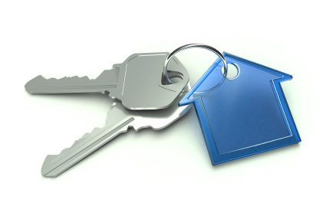
Authentication Protocol
Authentication Application

Slide 2
Authentication Protocol
Users wish to access services on servers.
used to convince each others identity and to exchange session keys.
Require the user to prove his identity for each service invoked
Require that servers prove their identity to clients
Provide security in a distributed architecture consisting of dedicated user workstations (clients), and distributed or centralized servers.
may be one-way or mutual.

Slide 3
Security Concerns
key concerns are
Confidentiality:-encrypt identification and session key info.
Timestamp:- to prevent replay attacks.
by using sequence numbers

Slide 4
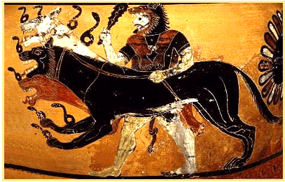
Kerberos
In Greek mythology, a many headed dog, the guardian of the entrance of Hades

Slide 5
What is Kerberos?
Developed as part of Project Athena at MIT
Open Source hence freely available
Provides centralised private-key third-party authentication in a distributed network
Provides single sign-on capability
Passwords (i.e: Secret Key) never sent across network
Key revocation can be achived by disabling a user at KDC.

Slide 6
How does Kerberos Works?
Uses an Authentication Server (AS)
Knows all user passwords, and stores in a DB
Shares a unique secret key with every user.
Send an encrypted ticket granting ticket
TGT contains a lifetime and timestamp

Slide 7
How does Kerberos Works?
Uses a Ticket Granting Server (TGS)
Issues tickets to users authenticated by AS.
Encrypted with a key only known by AS and TGS
Returns a service granting ticket
Service granting ticket contains timestamp and lifetime

Slide 8
Kerberos Dialog
Message Exchanges
Simplified approach
Client asks authentication server for ticket
AS exchange to obtain ticket-granting ticket
AS grants ticket
TGS exchange to obtain service granting ticket
Client sends ticket to server
Client/Server authentication exchange to obtain service

Slide 9
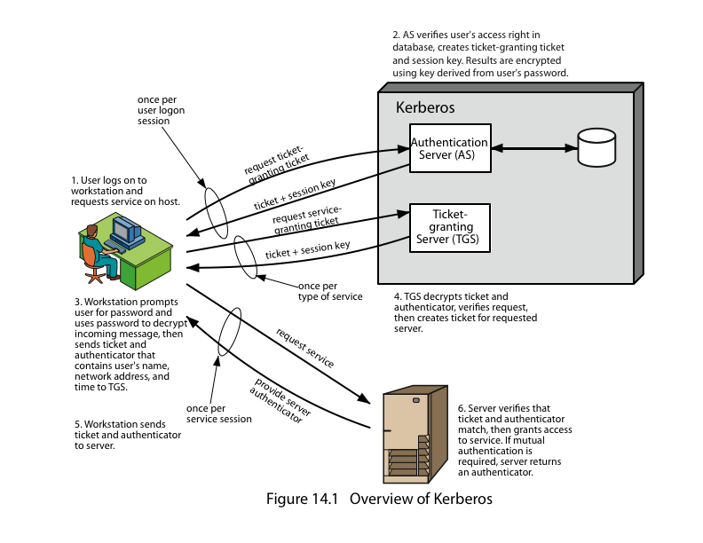

Slide 10
XYZ Service
SERVER
Key
Distribution
Center
Ticket
Granting
Service
Think “Kerberos Server” and don’t let yourself get mired in terminology.
Authen-
Tication
Service
Gurukul
Desktop
Computer
USER

Slide 11
XYZ Service
Key
Distribution
Center
Ticket
Granting
Service
“I’d like to be allowed to get tickets from the Ticket Granting Server, please.
Authen-
Tication
Service
Gurukul
Desktop
Computer
UID
USER
UID&PW

Slide 12
XYZ Service
Key
Distribution
Center
Ticket
Granting
Service
“Okay. I locked this box with your secret password. If you can unlock it, you can use its contents to access my Ticket Granting Service.”
Authen-
Tication
Service
Gurukul
Desktop
Computer
USER

Slide 13
XYZ Service
Key
Distribution
Center
Ticket
Granting
Service
Authen-
Tication
Service
Gurukul
Desktop
Computer
TGT
My Password
USER

Slide 14
TGT
Because Gurukul was able to open the box (decrypt a message) from the Authentication Service, he/she is now the owner of a “Ticket-Granting Ticket”.
The Ticket-Granting Ticket (TGT) must be presented to the Ticket Granting Service in order to acquire “service tickets” for use with services requiring Kerberos authentication.
The TGT contains no password information.

Slide 15
Kerberos Realms
a Kerberos environment consists of:
a Kerberos server
a number of clients, all registered with server
application servers, sharing keys with server
A Kerberos Realm
Set of managed nodes that share the same Kerberos database
To improve the performance
To over come failure issues due too single AS & TGS

Slide 16
Multiple Kerberi
Kerberos server in each realm shares a secret key with one another
There must be trust between the servers
i.e. each server are registered with one another
Does not scale well

Slide 17
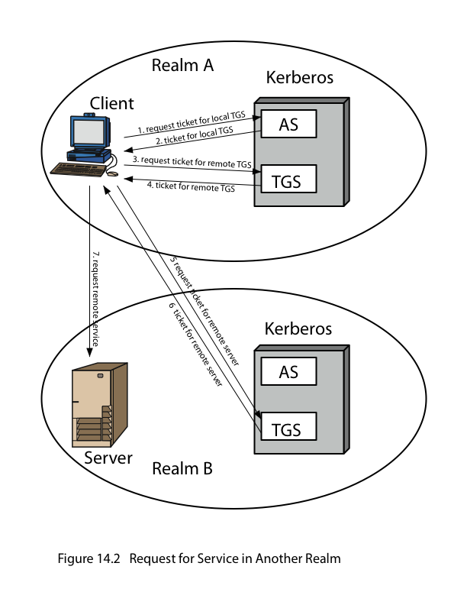

Slide 18
Kerberos Version 4
Pc=password of client
1- IDc + Pc+IDv
2- Ticket
3- IDc +Ticket
Ticket=Ekv[IDc,ADc,IDv]
kv=Secret Key between AS and V (Server)
IDc= User id of client

Slide 19
Kerberos Version 4
Weaknesses
Big load on AS (Provide secondary ticket-granting servers)
Repeated password entry (Password to AS seldom, tickets from TGS when needed, based on AS authentication)

Slide 20
Version 4 Authentication Dialogue
Problems:
Lifetime associated with the ticket-granting ticket
If to short  repeatedly asked for password
If to long  greater opportunity to replay
The threat is that an opponent will steal the ticket and use it before it expires

Slide 21
Strategies and Countermoves
What opponents of 4 can do
Wait for long-lived ticket-granting tickets and then reuse
Capture service-granting tickets and then use remaining time
Antitheft of ticket-granting tickets
AS provides both client with a secret, securely
Done by sending a session key
This procedure also makes service-granting tickets reusable

Slide 22
Kerberos Organization
Called a realm, it includes:
Kerberos server, which includes:
UID and hashed password for each user
Shared secret key with each user
Kerberos server includes both AS and TGS
Inter-realm issues
Kerberos servers in each realm are registered with each other (share a secret key)
TGS in server realm issues tickets to client on other realm (i.e RTGS)

Slide 23
Kerberos Version 5
Fixes version 4 environmental shortcomings
New elements for AS exchange:
Realm, Options, Times, Nonce
Client/server authentication exchange
Sub key, sequence number
Kerberos Ticket Flags

Slide 24
Difference Between Version 4 & 5
Point of Discussion | Version 4 | Version 5
Encryption Algorithm Used | DES only | DES & its variant, IDEA etc.
Identifiers | IP Address only | N/w Add, Type , length
Message byte ordering | Not Allowed | Allowed
Tickets Lifetime | Small | Renewable time span
Authentication forwarding | Same server only | Any server in realm
Inter-realm authentication Support (SCALING) | No Single Peer-to-peer | Yes Multiple Transitive (Cross-realm)
Replay Caches Support | No | Yes
Postdatabale Ticket | Not Available | Available
Forwardable (New Ticket) | Single ticket, same M/C, Same IP | Current credentials to get valid on another M/C

Slide 25
Attacks on Kerberos
Threats exist:
Modification Attack:- Network address of a workstation.
Replay Attack:-Eavesdrop while communication.
PW Guessing Attack:- User pretend to be another user.
Inter-session chosen Plaintext Attack:- As per V.5 Draft

Slide 26
Kerberos Mechanism Used By
Microsoft Passport Technology
Windows NT

Slide 27
Version 5 – Continued
Avoids double encryptions
Avoids PCBC (vulnerable to a cipher block exchange attack)
Session and sub-session keys
Pre-authentication – makes password attacks more difficult (but not impossible)

